Slide 1
Quality of Life

Slide 2
Communication

Slide 3
What is meaningful assessment
Framework for the development of expressive communication
The Communication Matrix
Implications for instruction

Slide 4
(symbolic) communication is an outgrowth of early relationships between infants, caregivers and the objects/events in their environment

Slide 5
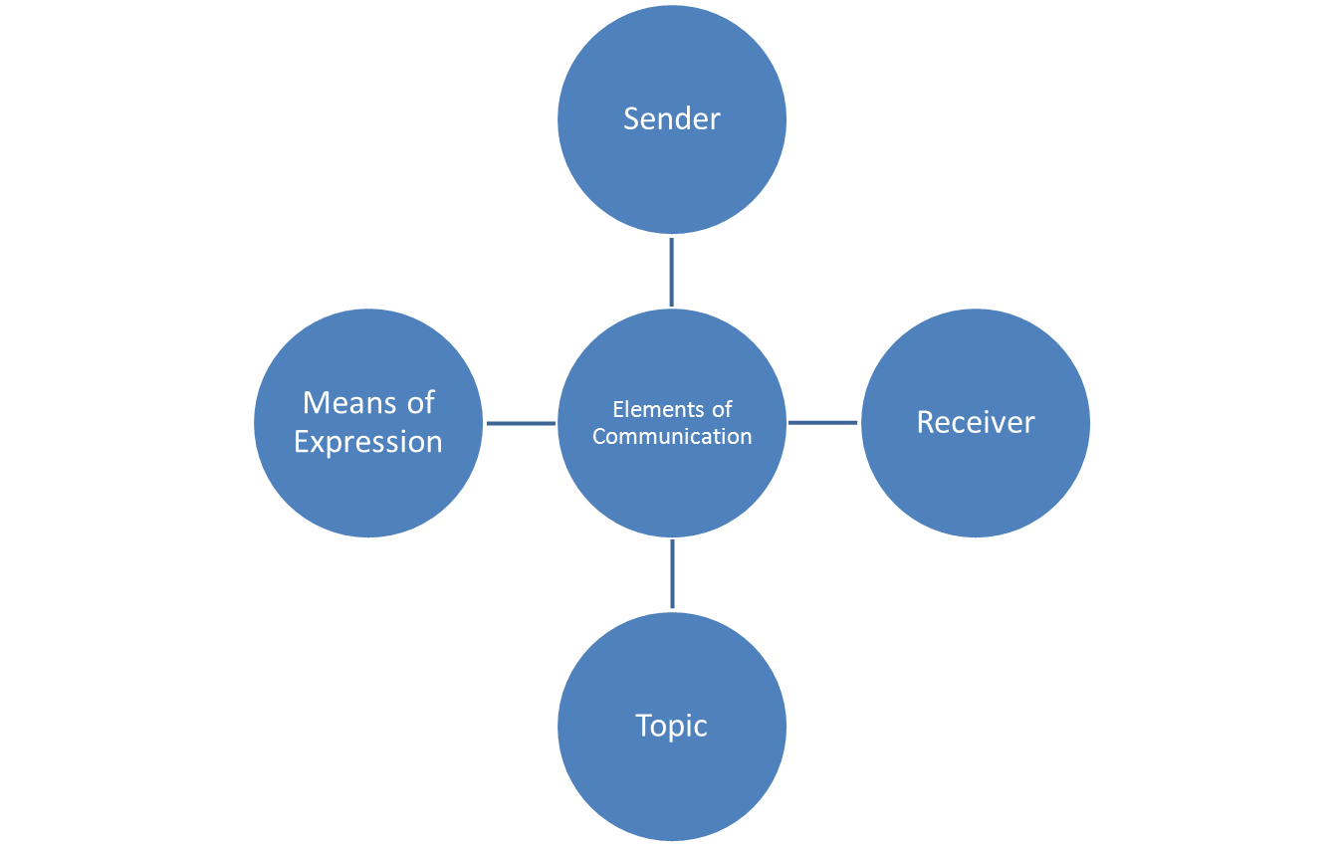
Four Elements of Communication
(see pages 3-4 First things First)

Slide 6
Perception of self occurs through interaction with people, knowledge of surroundings, and mastery of skills

Slide 7
The role of vision and hearing in helping children develop a sense of self separate of others
perceiving the distance between self and others
associating self produced sounds with their own movements or sounds that are produced by others
An understanding of the physical self provides a foundation for movement, exploration and early communication through body movements (Bruce,2005)

Slide 8
The recognition of the association between one’s behavior and environmental outcomes is critical for future learning. (Watson, 1966)

Slide 9
Through the responsiveness of the caregiver the infant begins to anticipate that his/her actions will cause change
The caregiver’s response to the infant’s behaviors as if it were communicative creates a mutual dialogue
The caregivers responsiveness to the infants signals is significantly correlated with the infants security of attachment, learning, and early development (Chen, Haney, 1995)

Slide 10
Early social/communicative interaction for the infant with sensory impairments
The infant lacks many of the cues from the parent (visual and auditory)
The infant may respond differently in response to the cues they do perceive ( quieting rather than turning toward the source or increasing movements

Slide 11
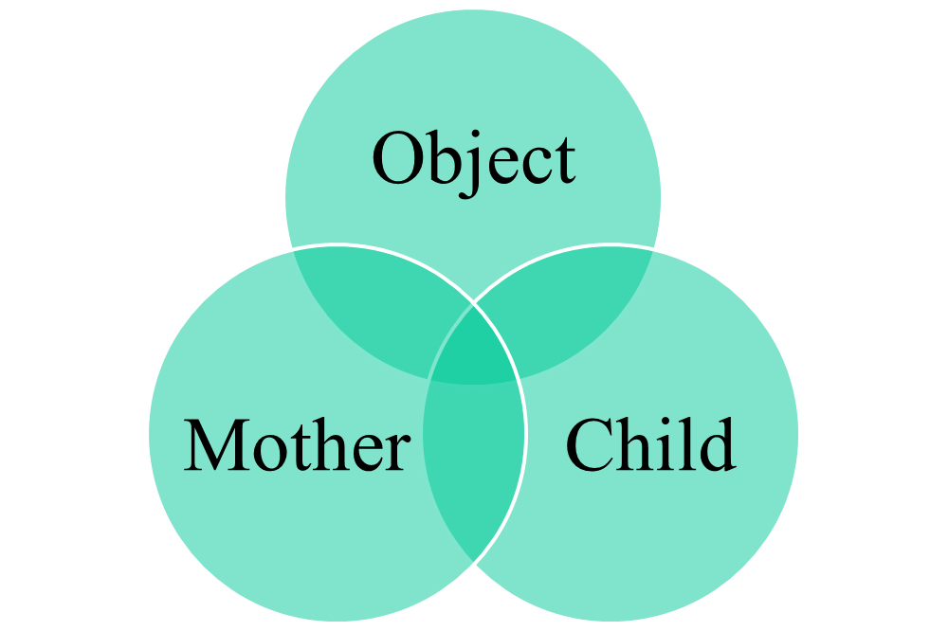
The act of reference emerges not as an individual act but as a social one (Werner and Kaplan 1963)

Slide 12
Children who are blind/VI or deaf blind learn about their world from a part to whole experience
Consistent and predictable environments help the child develop a sense of permanency
How they explore and how much they explore provides them with cues and associations thereby influencing their ability to recall objects and events in their world

Slide 13
Progressive Distancing
Decontextualization: spatial in a place other than here; and temporal from a time other than right now
Denaturalization: decreasing similarity between symbol and what it represents

Slide 14
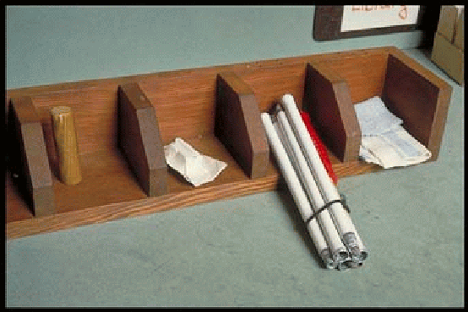

Slide 15
I.
Preintentional
Behavior
The child’s behavior is not under his own control. It is in reaction to things (such as feeling hungry or wet or sleepy). Parents interpret the child’s state from his general behaviors, such as body movements, facial expressions and sounds.
II.
Intentional Behavior
The child’s behavior is now intentional (under the child’s control), but she does not understand that “If I do this, Mom or Dad will do that for me”–in other words she does not communicate intentionally yet. Parents continue to interpret the child’s needs and desires from her behavior, such as body movements, facial expressions, vocalizations and eye gaze.
III.
Unconventional Communication
The child uses pre-symbolic behaviors intentionally to express his needs and desires to other people. They are called “unconventional” because they are not socially acceptable for us to use as we grow older: they include body movements, vocalizations, facial expressions and simple gestures (such as tugging on people).
IV.
Conventional Communication
The child uses pre-symbolic behaviors intentionally to express her needs and desire to other people. “Conventional” gestures include behaviors such as pointing and nodding the head “yes”. We continue to use conventional gestures as adults to accompany our language. Note that many of these gestures (and especially pointing) require good visual skills and may not be appropriate for children with severe vision impairment.
V.
Concrete Symbols
Symbols physically resemble what they represent in a way that is obvious to the child—they look like, feel like, move like or sound like what they represent. Concrete symbols include picture symbols, objects used as symbols (such as a shoelace to represent “shoe”), certain “iconic” gestures (such as patting a chair to say “sit down”) and sounds (such as making a buzzing sound to refer to a bee). Children with severe physical impairments may access picture and object symbols through the use of a mechanical device or by pointing, touching or eye gaze.
VI.
Abstract
Symbols
The child uses abstract symbols such as speech, manual signs, or Brailled or printed words. These symbols do not look, feel, or sound like what they represent. They are used one at a time.
VII.
Language
The child combines symbols (any sort of symbols) into ordered two- or three-symbol combinations (“want juice”, “me want juice”), according to grammatical rules. The child understands that the meaning of word combinations may differ depending upon how the symbols are arranged.

Slide 16
Gestures
Effective
They are Generic. A single gesture may be used to refer to many things
Can be used to communicate about only that which is happening now and here

Slide 17
Communicative Intent
Is shaped by caregivers responding to pre-intentional behavior as if it were intentionally communicative

Slide 18
Intentional Communication
Implies
Intentional behavior
Purposefully directed toward another person with intended meaning
Requires dual orientation to both the communication partner and the topic

Slide 19
Communicative Intent
May rely on social negotiation of meaning between sender and receiver because the intended meaning may not be clear
Creates a degree of interdependency between sender and receiver
Not uncommon to misinterpret intent in AAC use (e.g. points to a picture is he making a request or commenting)

Slide 20
Characteristics of Intentional Communication
Persistence
Repetition
Alternating Gaze (body orientation, leaning toward)
Changing the signal used
Awaiting a response
Terminating the signal when responded to
Indicating satisfaction or dissatisfaction to response (Wetherby& Prizant 1989)

Slide 21
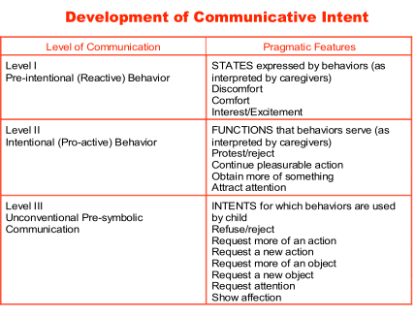

Slide 22
#4
Communication Intervention for Children with Severe and Multiple Disabilities
Charity Rowland, PhD., & Philip Schweigert, M.Ed.
Oregon Health & Science University
Design to Learn Projects
1600 SE Ankeny, Portland, Oregon

Slide 23
“Assessment that does not lead to improved student performance serves no useful purpose” (Bradley-Johnson, 1994)

Slide 24
“…most normed early communication assessments rely on specific physical or sensory behaviors that may not be accessible to children with physical and /or sensory impairments”
(C. Cress 2014)

Slide 25
Authentic* Assessment
(*worthy of acceptance because of accuracy) Bagnato 2009; Bagnato & Neisworth 1999

Slide 28
Assessment of Early Communication
www.communicationmatrix.org
Dr. Charity Rowland

Slide 29
Basic Sequence of Receptive Communication Development

Slide 30
Awareness
Reacts to People and may begin to orient towards them
Example: Quiets fusses stiffens when engaged by another person May begin to turn or lean toward them when engaged by them

Slide 31
Anticipation
Orients toward people and may begin to attend to their communicative behavior
Example Quiets and orient to, touching or tactually exploring the person when engaged. Shows general anticipation such as smiling, reaching toward, when engaged by another person

Slide 32
Recognition
Attends to another's communication and responds to their specific behaviors and intents
Shows specific response associated with a specific cue from other person such as leans forward when presented with a bib, or bounces when assisted to touch the therapy ball

Slide 33
Intervention
Is about building on what we understand about the child and her knowledge of and relationship to the social and physical world

Slide 34
Goal setting
What level of communicative competence to target (I-VII)
What communicative behaviors and intents/functions to target

Slide 35
Considerations
Does the learner readily exhibit her current communication skills whenever the opportunity arises or does it only occur when she is given very specific prompts
Is the learner able to use his present skills across a variety of topics settings and with different partners

Slide 36
Where to target communication opportunities
Ideally any- and every- where
If necessary pick those situations
where the child’s interests are the greatest
valued by the learner and his or her family
and where you can insure the most consistency from the social environment
predictable routines are necessary before we can expect our learner to indicate a desire to reinstate such interactions

Slide 37
Pre-Symbolic Communication
Key Elements of Individualized Instruction
(see page 10 First Things First)
MOTIVATION: What are reinforcing topics and settings for the learner to communicate about?
POTENTIAL RESPONSES: How will the learner express himself/herself?
GAINING ATTENTION: How will the learner initiate communication with others?
REINSTATEMENT: How will the learner indicate to another person that s/he would like to continue an interaction?
REQUESTING/CHOICEMAKING: How will the learner indicate his/her preference between two or more objects?
PROMOTING PROGRESS: How do you design instruction to promote steady progress?

Slide 38
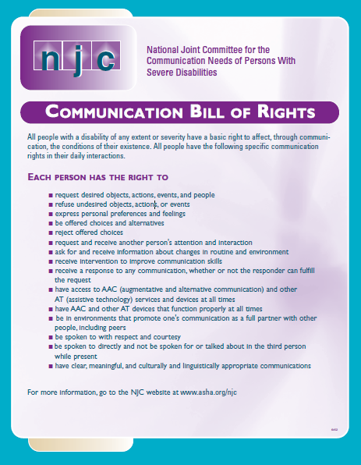

Slide 39
Three essential building blocks of communication…
Spontaneous signals..
for gaining attention to initiate social interaction
for accepting what is currently happening
for rejecting the current status of things
Beukelman and Mirenda (2013) Augmentative and Alternative Communication; Supporting children and adults with complex communication needs

Slide 40
Level I
GOALS | ACTIVITIES
Expresses Interest | Conduct preference probes
Demonstrates Preferences | Provide response contingent learning experiences social/motor/sensory stimuli
Demonstrate contingency awareness/intentional behavior | Provide repeated opportunities to experience stimuli

Slide 41
Janssen, Riksen-Walraven, &Van Dijk, 2003 describe characteristics of Harmonious interactions including;
mutual attention implying that child and partner are open to each other and shared attention
reciprocal attunement requiring contingent responsivity, sensitivity to each others’ signals and leaving space/pausing for the other to take a turn
adequate emotional regulations which refers to the ability to maintain or regain an appropriate arousal level

Slide 42
Level II
GOALS | ACTIVITIES
Child will indicate desire to repeat preferred interaction initiated by partner Child will indicate desire for more of an object that she has just had Child will indicate differentiated response for different stimuli (e.g. repeat bouncing movement during pause in bouncing on ball, leans forward/backward for more rocking) will increase # of topics of interest | Engage child in consistent variety of social interactions with pauses to allow child to indicate desire to continue or stop or change Engage child in consistent variety of interactions with objects pausing to allow child to indicate desire to continue or stop or change Explore new objects/interactions with learner

Slide 43
Level III
GOALS | ACTIVITIES
will demonstrate ability to discriminate objects from array to find desired object Will request attention to make requests or make a choice from array that is accessible will engage receiver and express desire to terminate interaction with topic will increase # of topics of interest will demonstrate ability to request attention from receiver when in close proximity and within (5) feet | -Observe learner to determine best channel(s) for taking in information and discriminating between -Present learner with array of objects to examine/select from -Explore new objects/activities with shared/motivating features in multiple opportunities -Identify and increase activities that learner can make choices in - Sabotage familiar activities to encourage learner to persist, or change effort to gain attention

Slide 44
Levels V-VII
GOALS | ACTIVITIES
Learner demonstrates 1:1 correspondence between symbol and referent to make choices, or to request Learner demonstrates 1:1 correspondence between symbol and referent to request objects not present Learner will gain the attention of a receiver and use symbol to make request for desired item/activity (see also suggestions for promoting progress ) | During an activity make sure learner is aware of all available topics (they are present ..visually, tactilely and/or auditorally accessible) learner makes request for desired object During familiar activity learner will make request for desired object and then retrieve corresponding object to confirm Ensure that symbol system is accessible to learner at all times Create opportunities for learner to develop and practice new communicative intents (e.g. to label or comment; to direct attention; to answer questions)

Slide 45
Types of Tangible Symbols
LEVELS OF REFERENT SYMBOL
REPRESENTATION
Raisins
Bolt
Shoe
Bicycle
Car/Out
Eating
Pretzel
Multicolored
Vinyl
Therapy Ball
Work Table
Cafeteria
A few raisins glued to a piece of cardboard
A bolt is shrink-wrapped onto cardboard backing
Shoelace
Handle Grip
Car Key
Spoon
Thermoform of pretzel (shares shape & size with referent
Wood block covered with multicolored vinyl
Shares texture and color with referent; for blind individuals only one feature <texture> is shared
Ribbed rubber mat is attached to table: a small piece of the mat serves as the symbol
Wooden apple shape is attached to cafeteria door: a similar shape serves as the symbol
Identical Object
Partial or Associated
Object
One or Two Shared
Features
Artificial Association
Photographs -Self Explanatory-
Line Drawings -Self Explanatory-

Slide 46
“Tangible” Means…
Physically Tangible
Conceptually Tangible- to the INDIVIDUAL
USER (eye of the beholder)

Slide 47
http:/www.osepideasthatwork.org/toolkit/

Slide 48
Promoting Progress
How do you help the child to keep learning?
Expand vocabulary
Increase size of symbol array
Generalize the use of symbols to other situations and with other people
Teach new functions
Multi-symbol utterances
Portability
Change symbol type

Slide 49
Fast mapping
As the learner begins to acquire vocabulary at a certain level of symbolic representation new vocabulary may be learned at a faster rate
Moving the learner to a more abstract level too soon rather than allowing them to develop a meaningful vocabulary at the current level may preclude this fast mapping

